Slide 1
Exploring Pandas
Lesson 4.2

Slide 2
Class Objectives
By the end of today’s class, you will be able to:
Navigate through DataFrames using loc and iloc.
Filter and slice Pandas DataFrames.
Create and access Pandas groupby objects.
Sort DataFrames.

Slide 3
Exploring Data with loc and iloc

Slide 4
Programmers can easily collect specific rows and columns of data from a DataFrame by using the loc and iloc methods.

Slide 5
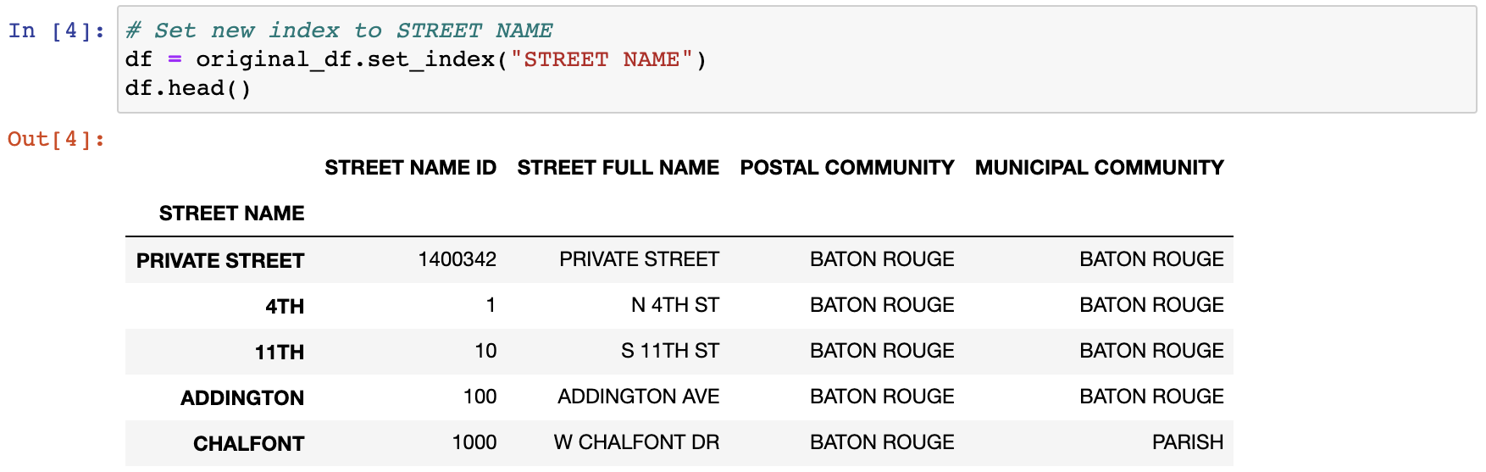
Exploring Data with loc and iloc
loc returns data based on an index of labels/strings
loc is limited to string types and cannot be used on a numerical index. As an alternative solution, you can use the df.set_index() function, passing in the desired column header for the index.
Instead of using labels, iloc uses integer-based indexing for selection by position.

Slide 6
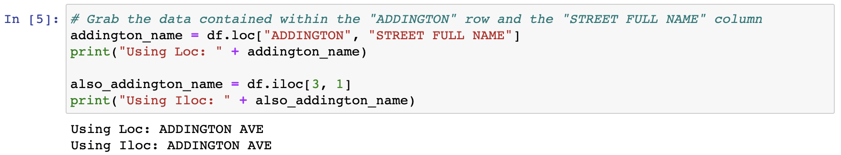
Exploring Data with loc and iloc
Both loc and iloc use brackets that contain the desired rows, followed by a comma and the desired columns.
For example, loc[“ADDINGTON”, “STREET FULL NAME”] or iloc[3,1]

Slide 7
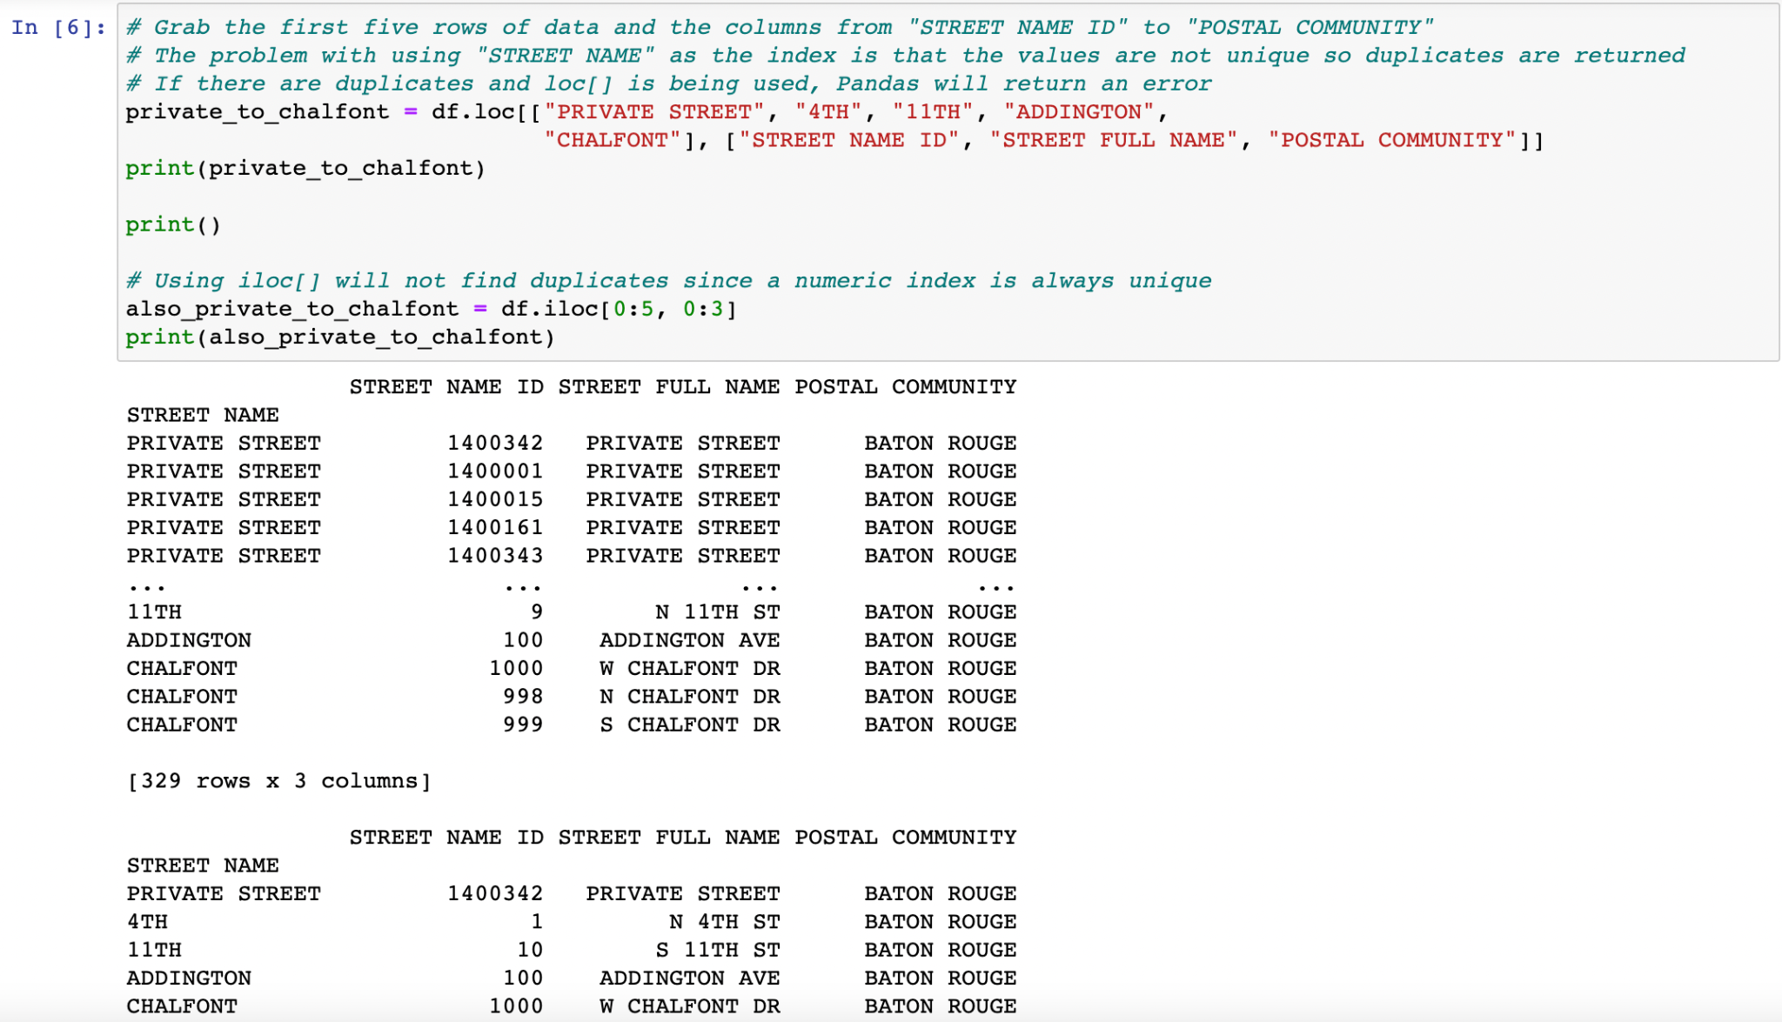
Exploring Data with loc and iloc
Both methods allow us to select a range of columns and rows by providing a list.
We can also use a colon to tell Pandas to look for a range.

Slide 8
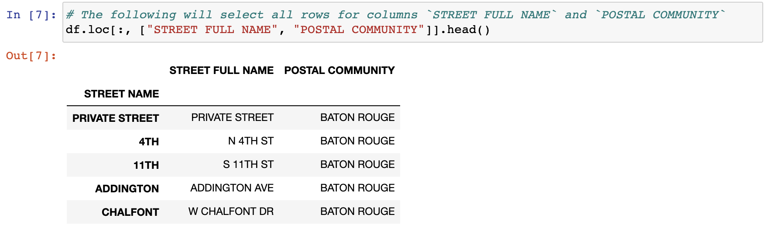
Exploring Data with loc and iloc
By passing in a colon by itself, loc and iloc will select all rows or columns depending on where the colon is placed in relation to the comma.

Slide 9
loc and iloc can be used to conditionally filter rows of data based on the values within a column.

Slide 10
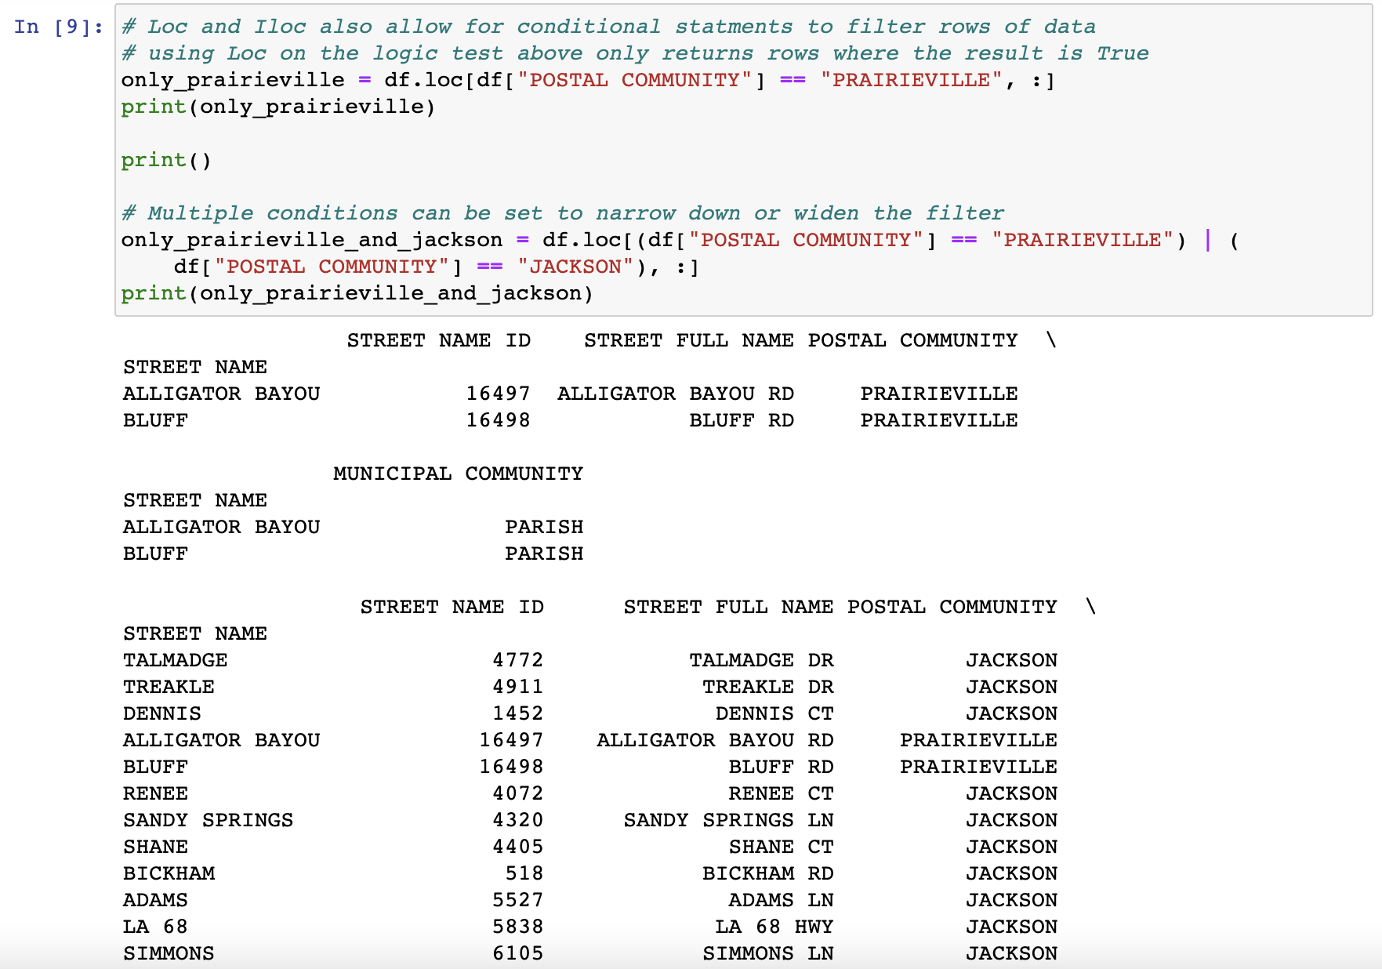
Exploring Data with loc and iloc
Instead of passing a list of indexes, we can use a logic statement.
If multiple conditions should be checked, & and | may also be added into the logic test as representations of and and or.

Slide 11
Activity: Good Movies
In this activity, you will create an application that searches through
IMDb data to find only the best movies out there.
20 minutes

Slide 12
Activity: Good Movies
Instructions:
Use Pandas to load and display the CSV provided in Resources.
List all the columns in the dataset.
We're only interested in IMDb data, so create a new table that takes the film and all the columns related to IMDb.
Filter out only the good movies—any film with an IMDb score greater than or equal to 7—and remove the norm ratings.
Find less popular movies that you may not have heard about—anything with under 20,000 votes.
Finally, export this file to a spreadsheet, excluding the index, so we can keep track of our future watchlist.

Slide 14
Cleaning Data

Slide 15
Activity: Pandas Recap and Data Types
Instructions | Open PandasRecap.ipynb in the Unsolved folder in your Jupyter notebook.
 | Go through the cells, and follow the comments.
Hints | A list of a DataFrame's data types can be checked by accessing its dtypes property.
 | To change a non-numeric column to a numeric column, use the df.astype(<datatype>) method and pass in the desired data type as the parameter.

Slide 16
When dealing with massive datasets, it’s almost inevitable that we’ll encounter duplicate rows, inconsistent spelling, and missing values.

Slide 17
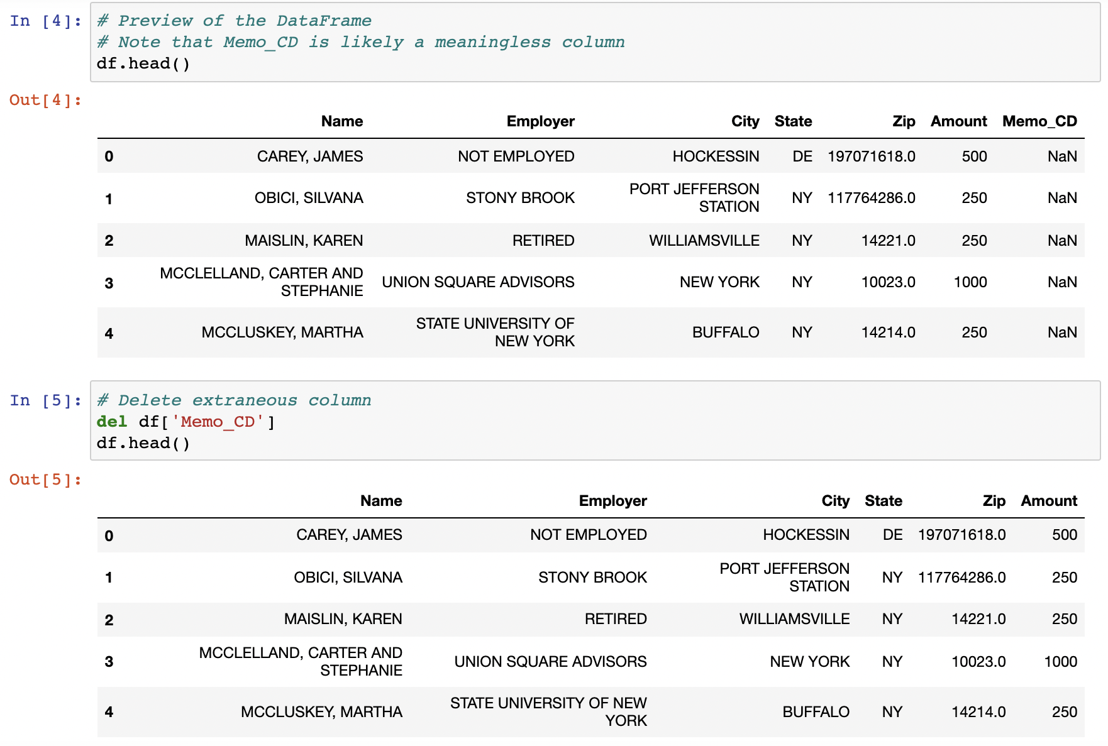
Cleaning Data
del <DataFrame>[<columns>]

Slide 18
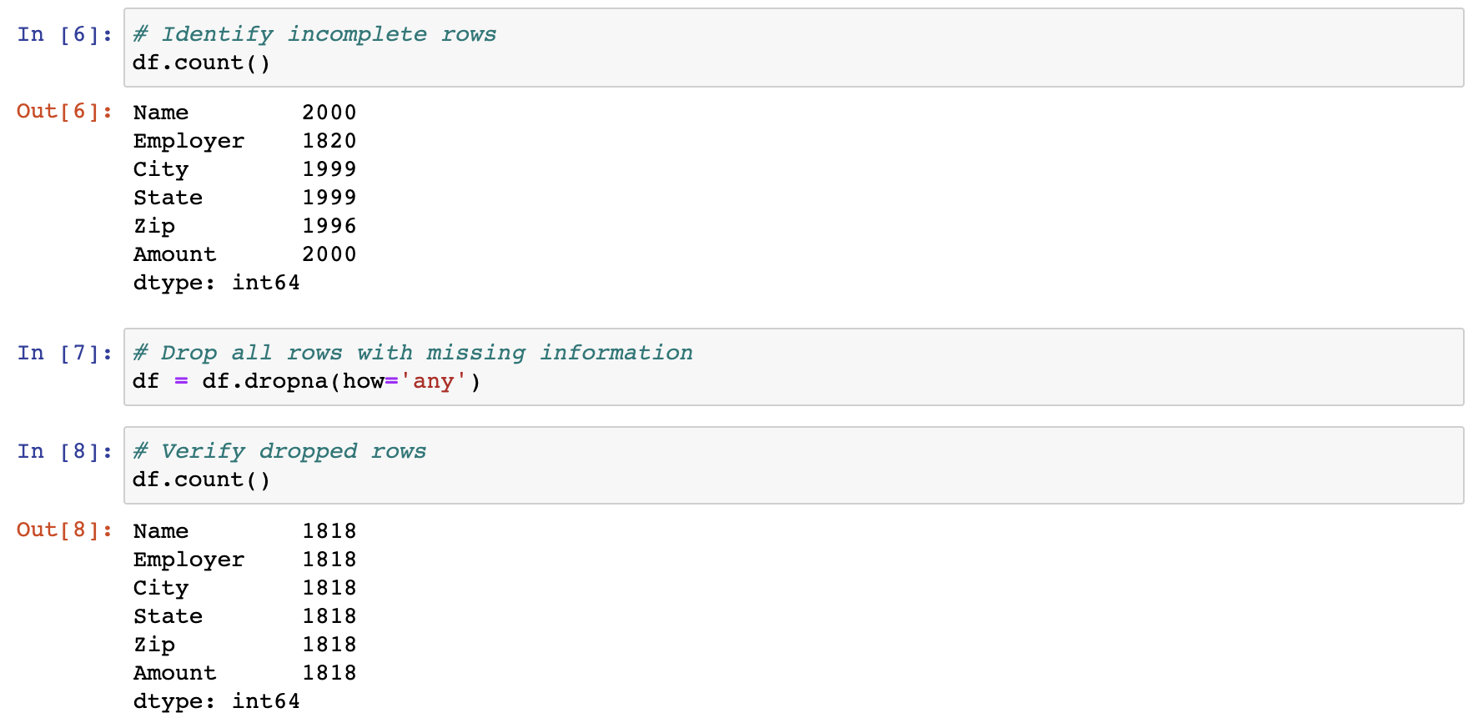
Cleaning Data
count()
<DataFrame>.dropna(how=’any’)

Slide 19
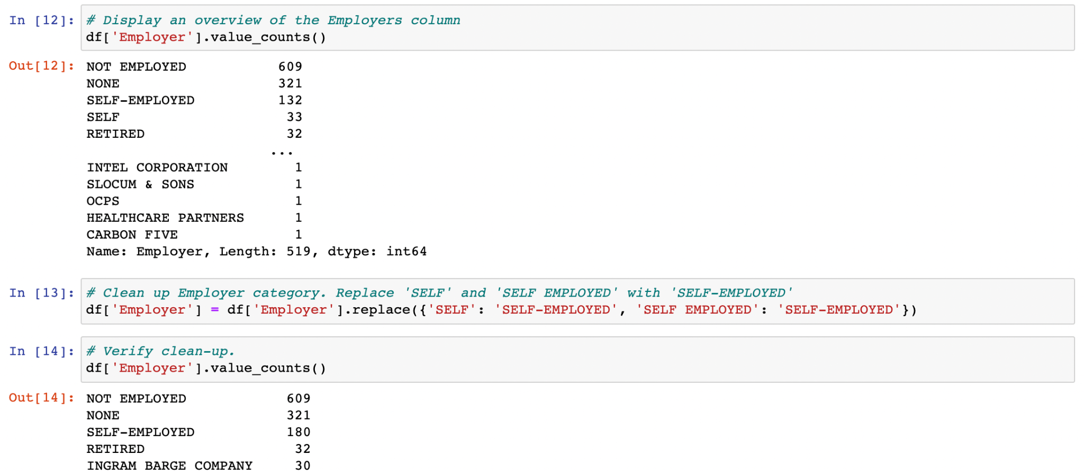
Cleaning Data
value_counts()
replace()

Slide 20
Activity: Hong Kong LPG Appliances
In this activity, you will take an LPG appliance dataset from Hong Kong, and clean it so that the DataFrame is consistent, and that there are no rows with missing data.
20 minutes

Slide 21
Activity: Hong Kong LPG Appliances
Instructions:
Read in the CSV by using Pandas, and print out the DataFrame that is returned.
Reduce the DataFrame to only the columns in English.
Get a count of the rows within the DataFrame to determine if there are any null values.
Drop the rows that contain null values.
Search through the "Applicant" column, and replace any similar values with one consistent value.
Create a couple DataFrames that look into one Place of Manufacture only, and print them to the screen.

Slide 23
Activity: Pandas Recap and Data Types
In this activity, we will recap what has been covered in Pandas up to this point.
15 minutes

Slide 24

Notes:
-------------------
Image source: AdobeStock_56885471

Slide 25
Pandas Grouping

Slide 26
.groupby() is a simpler method for filtering data.

Slide 27
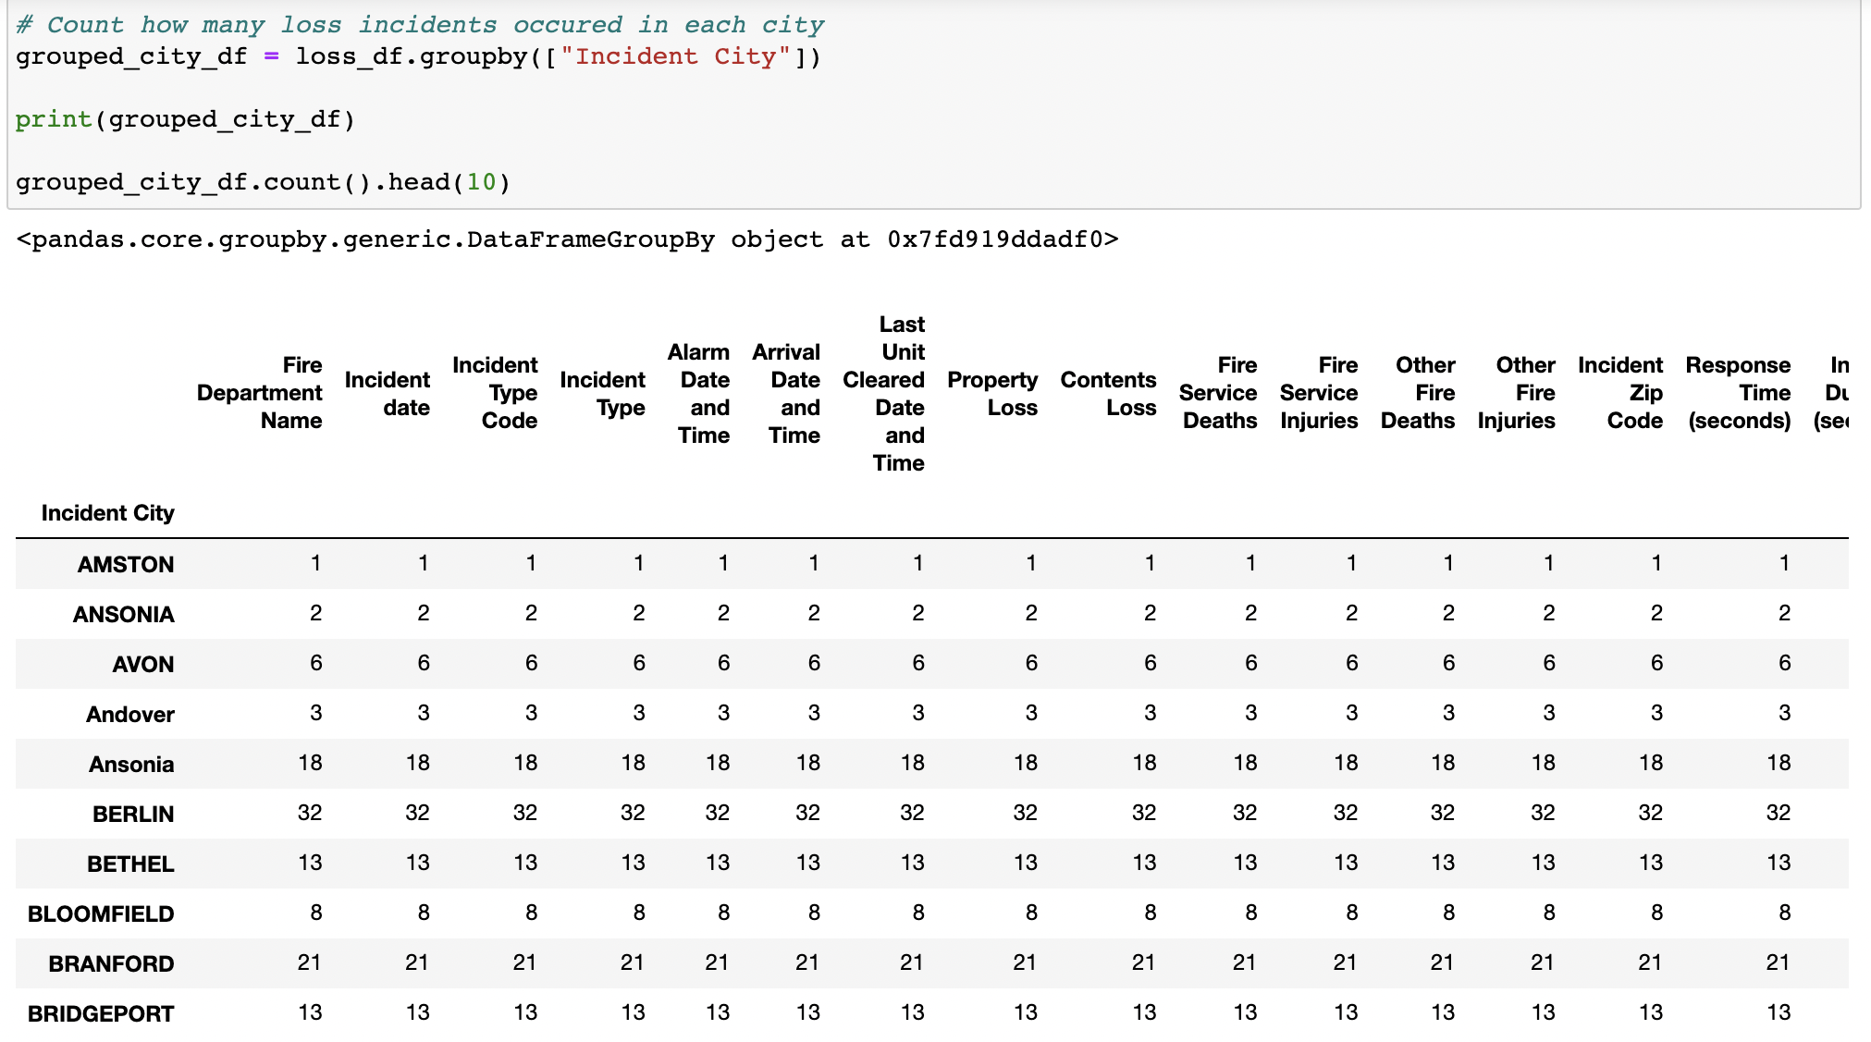
Pandas Grouping
To split the DataFrame into multiple groups and group by state, we use df.groupby([<Columns>]).
The .groupby() method returns a groupby object that can only be accessed by using a data function on it.

Slide 28
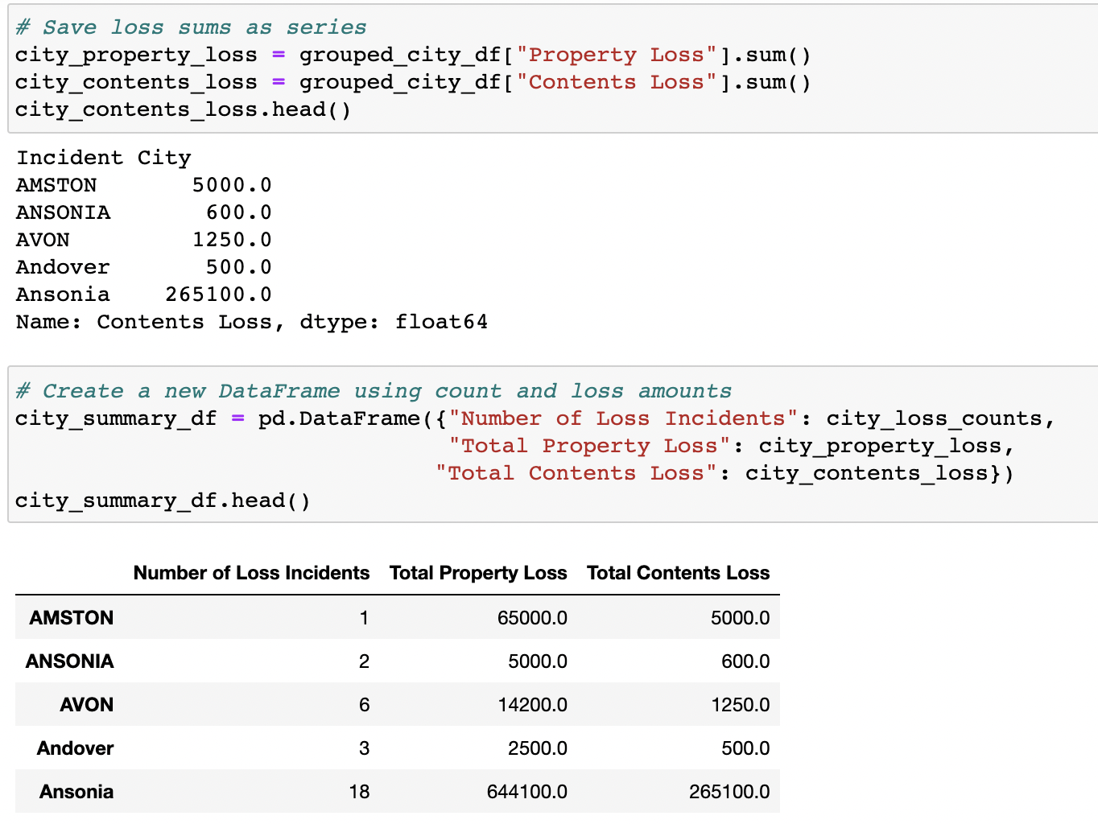
Pandas Grouping
The pd.DataFrame() method makes it possible to create new DataFrames by using only groupby data.
A DataFrame can also be created by selecting a single Series from a groupby object and passing it in as the values for a specified column.

Slide 29
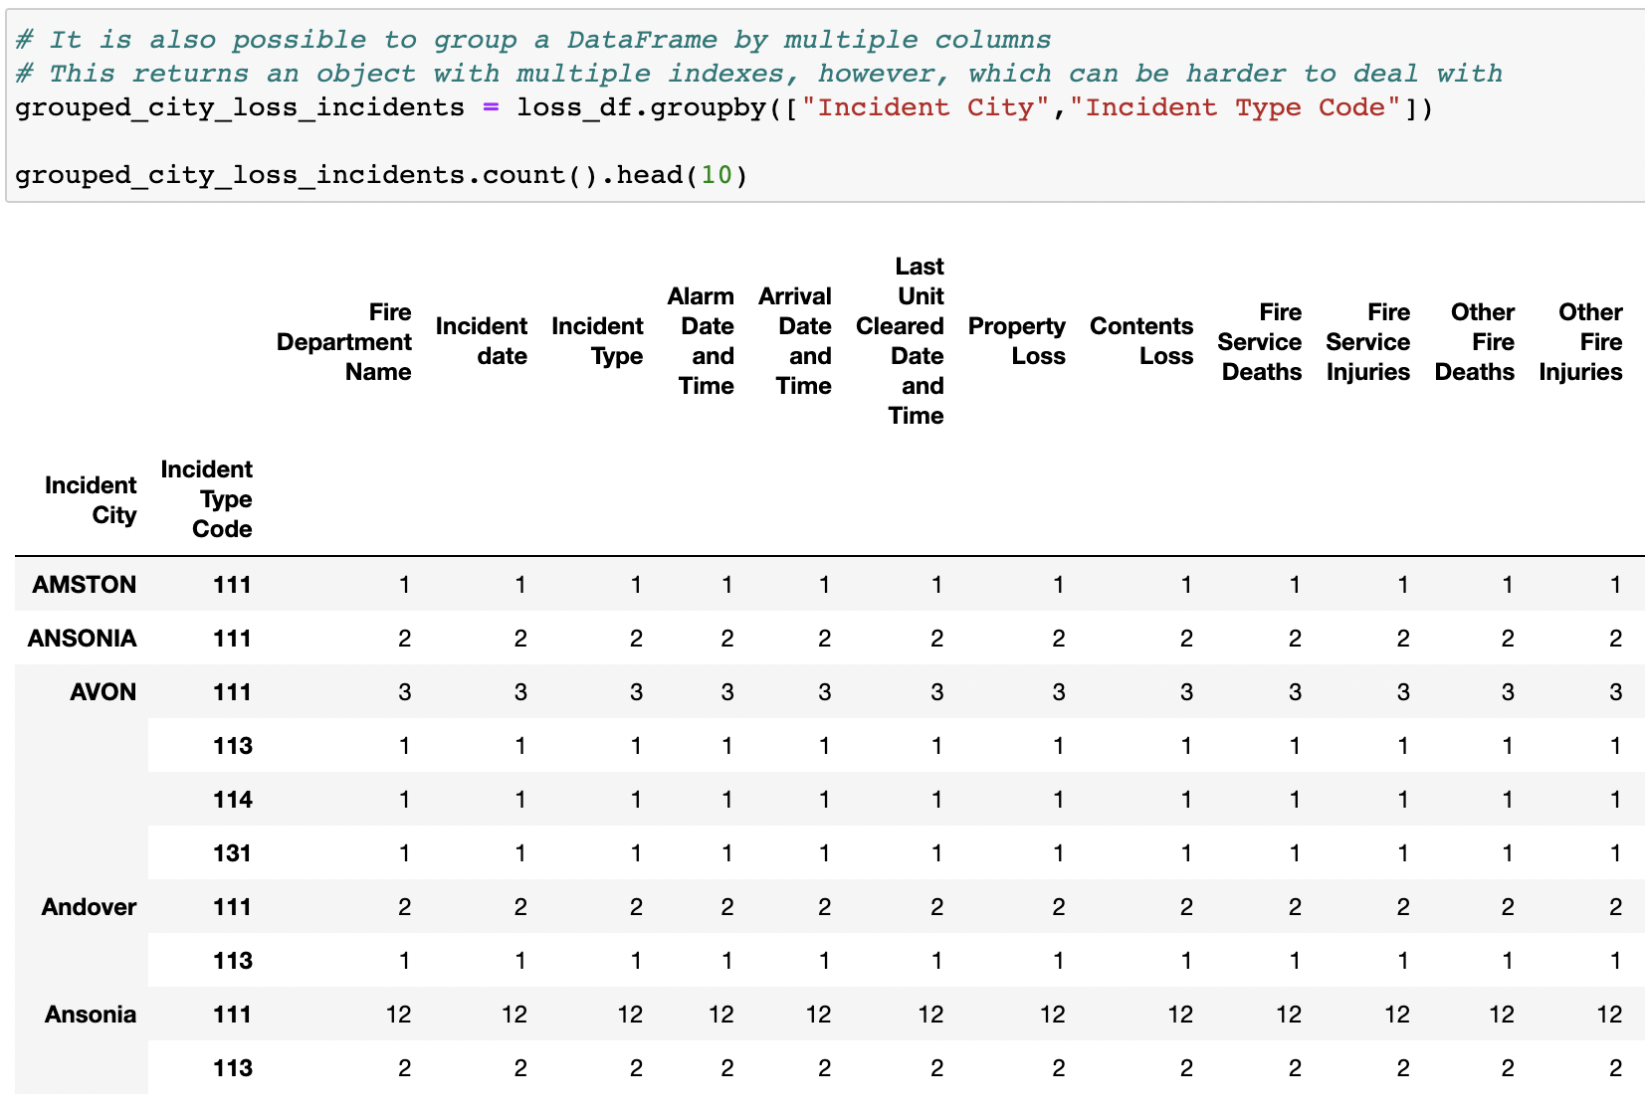
Pandas Grouping
It’s also possible to perform a df.groupby() method on multiple columns by passing two or more column references into the list parameter.

Slide 30
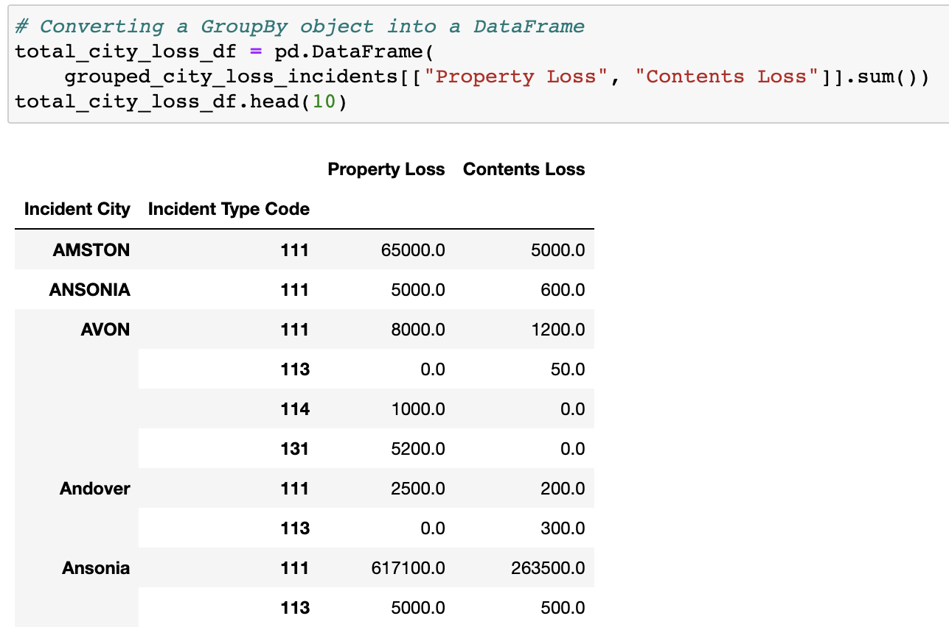
Pandas Grouping
A new DataFrame can be created from a groupby object.

Slide 31
Activity: Exploring U.S. Census Data
In this activity, you will revisit the U.S. Census data and create DataFrames with calculated totals and averages of each state by year.
25 minutes

Slide 32
Activity: Exploring U.S. Census Data
Instructions | Read in the Census CSV file with Pandas.
 | Create two new DataFrames, one to find totals, and another to find averages. DataFrames should include: Totals for population, employed civilians, unemployed civilians, people in the military, and poverty count. Averages for median age, household income, and per capita income.
 | Create new DataFrames once these have been grouped by each year and state.
 | Rename any columns to reflect the data calculations.
 | Export the resulting tables to CSVs. We will use them again in our next class.

Slide 34
Sorting Made Easy

Slide 35
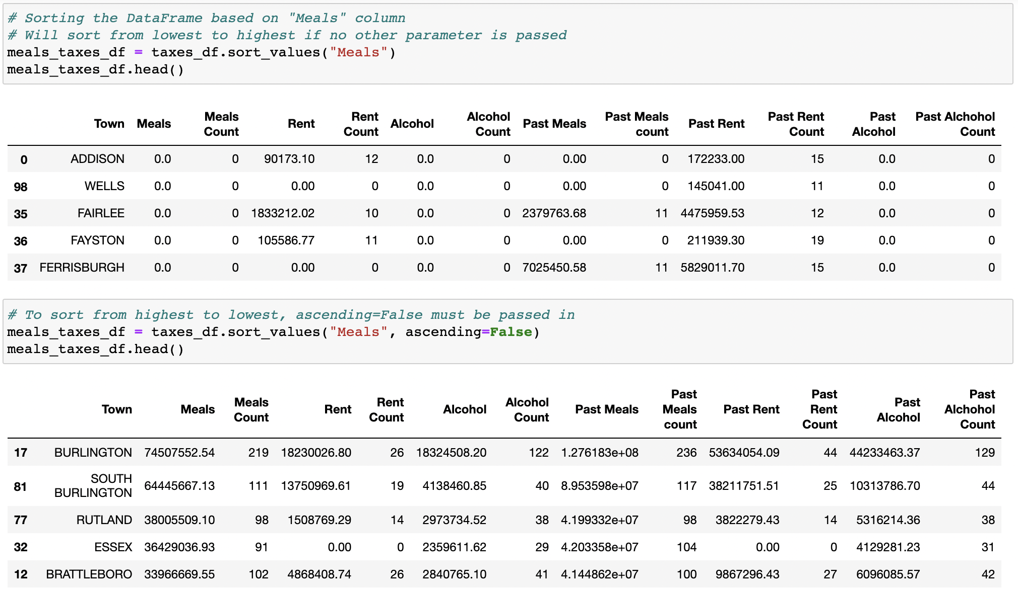
Sorting Made Easy
To sort a DataFrame based on the values within a column, use the df.sort_values() method and pass in the column name to sort by as a parameter.
The "ascending" parameter is always marked as True by default. Therefore, the sort_values() method will always sort from lowest to highest unless the parameter of ascending=False is also passed into the sort_values() method.

Slide 36
Activity: Search for the Worst
In this activity, you will take a dataset on San Francisco Airport's utility consumption and determine which day in the dataset had the worst consumption for each utility.
20 minutes

Slide 37
Activity: Search For the Worst
Instructions:
Read in the CSV file provided, and print it to the screen.
Print out a list of all the values within the "Utility" column.
Select a value from this list, and create a new DataFrame that only includes that utility. Note that some utilities have more than one option for "Owner," and you may want to limit this new DataFrame to a single "Owner."
Sort the DataFrame based on the level of consumption, from most to least.
Reset the index for the DataFrame so that the index is in order.
Print out the details of the worst day to the screen.

